Slide 1
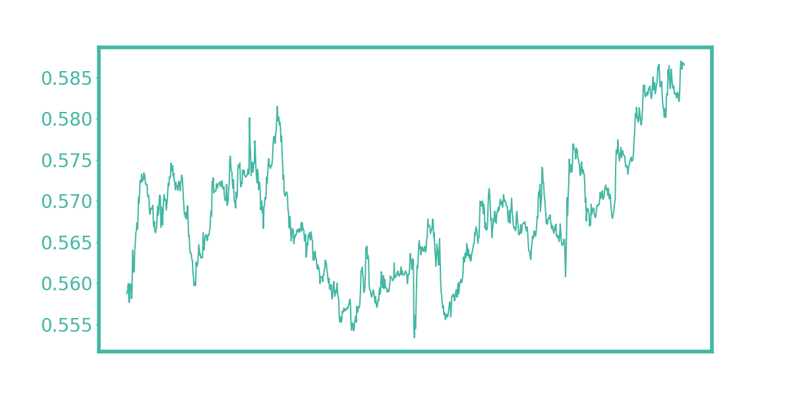
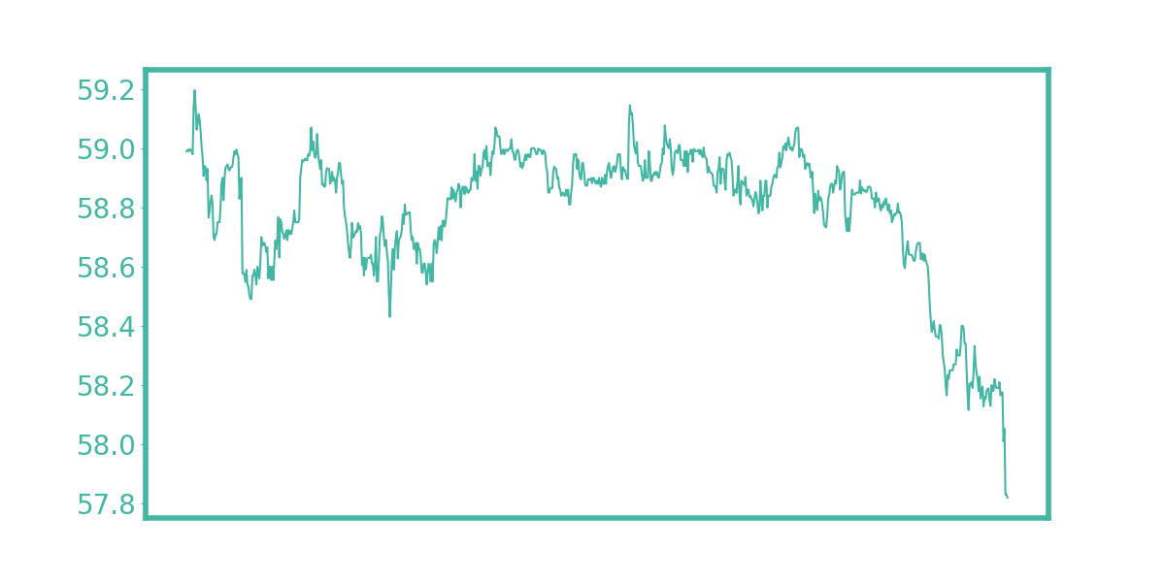
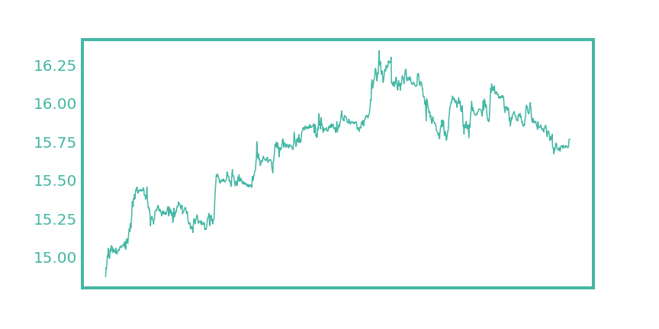
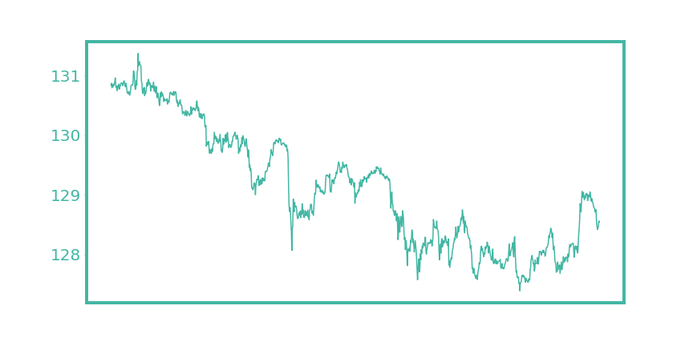
Last Update: 28 Oct 2022 00:45
Top 5
Bottom 5
Name | Last Price | Change | % Change
NZD/USD | 0.5865 | 0.0036 | +0.62%
USD/RUB | 61.66 | 0.36 | +0.59%
AUD/USD | 0.6472 | 0.0016 | +0.25%
EUR/USD | 0.9989 | 0.0022 | +0.22%
USD/MYR | 4.7215 | 0.0085 | +0.18%
Name | Last Price | Change | % Change
USD/PHP | 57.82 | -0.37 | -0.64%
USD/IDR | 15525.0 | -40.0 | -0.26%
USD/ZAR | 17.9322 | -0.0443 | -0.25%
USD/SGD | 1.4067 | -0.0029 | -0.20%
USD/THB | 37.716 | -0.067 | -0.18%
NZD / USD
USD / PHP

Slide 2
I love Hunter Bevis solve my problem today!!!

